Slide 1
Hotel aggregator analysis
Power bi visualization
DISHA RAJAK

Slide 2
Problem statement
This project aims to analyze a dataset of hotel aggregator listings using Power BI. The dataset comprises various attributes related to listings, hosts, reviews and availability. The main objective is to create a comprehensive visualizations and insights that shed light on trends, patterns, and factors influencing the performance of listings.

Slide 3
Project Objectives
Geographical insights:
To identify popular neighborhoods, we explore the geographical concentration of listings and host location.
Pricing trends:
we analyze pricing trends based on property types, room types, and accommodation capacity.
Host Characterstics:
Including superhost status, response times, and verification methods.
Review scores:
We try to identify areas for improvement based on specific review categories.

Slide 4
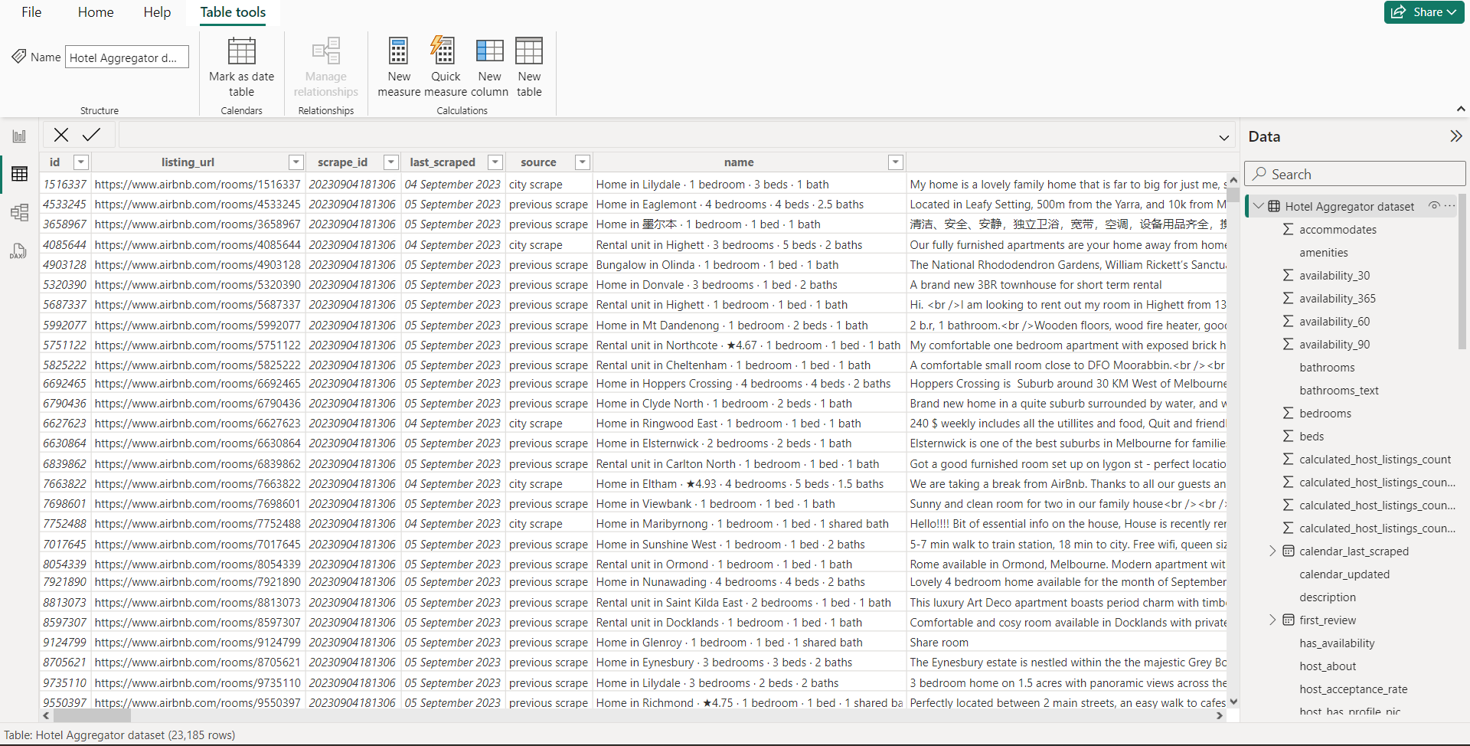
Load the dataset in Power BI

Slide 5
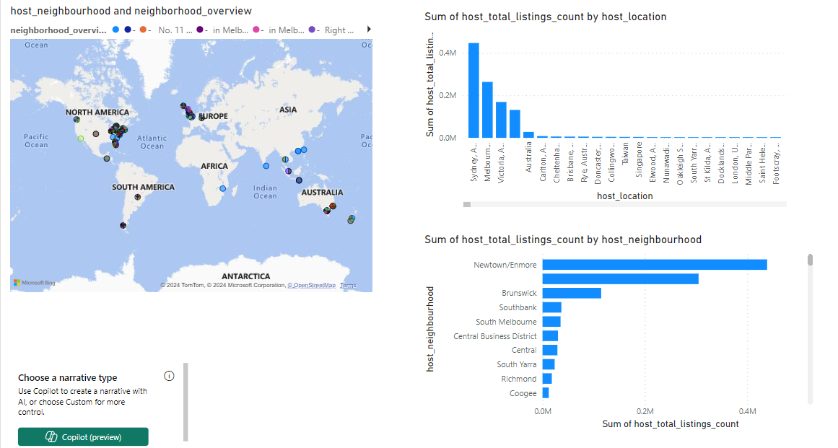
Geographical Distributions in Dashboard

Slide 6
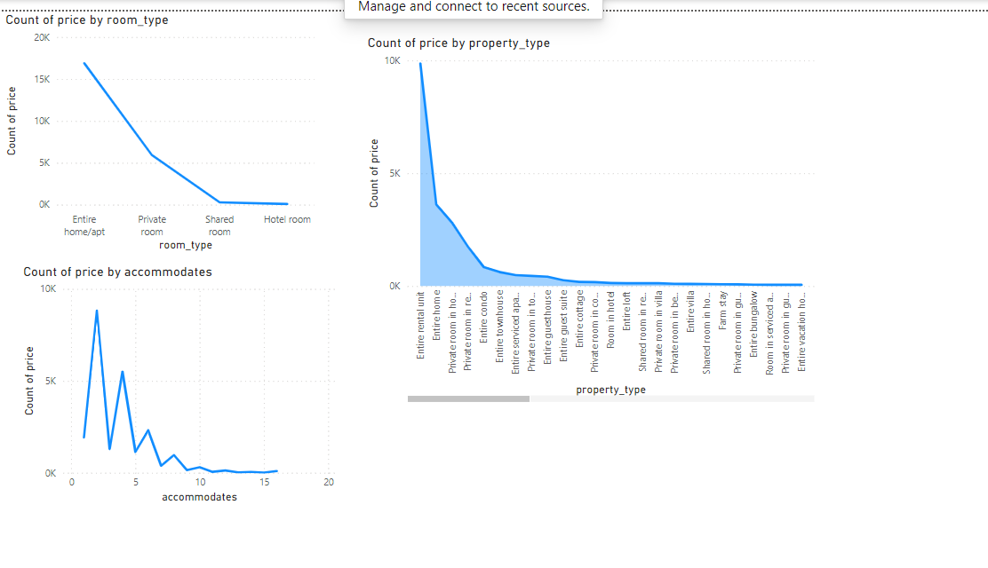
Pricing Trends Dashboards

Slide 7
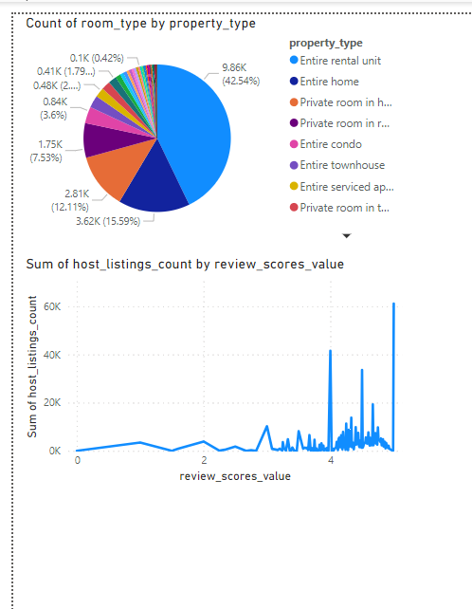
Host Performance

Slide 8
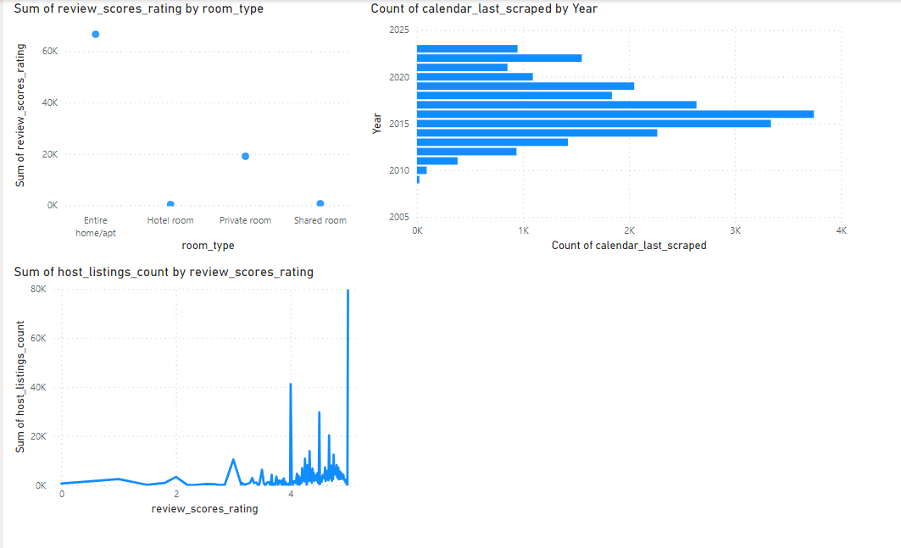
Review Scores and Guest Satisfaction

Slide 9
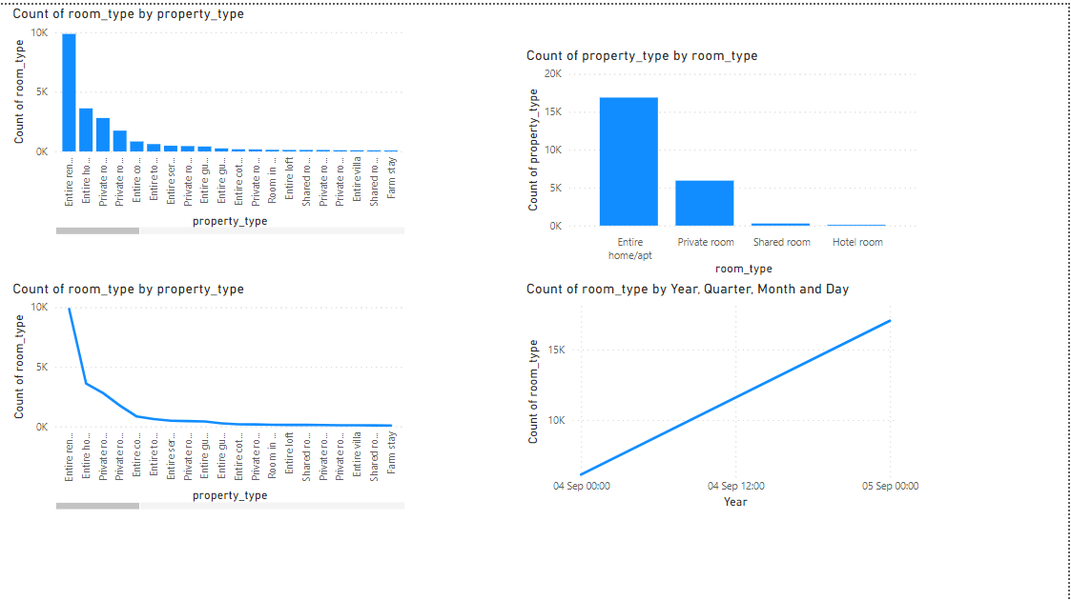
Property Type and Room Analysis

Slide 10
Recommendations
Since 2016, the yearly availability is highly decreasing. Therefore , it is important to work on increasing the availability on yearly level.
Capacity of accommodation doesn’t have a [proportional relationship with price.
The shared room type is the only type that can be affordable.
The response rate doesn’t affect the super host status.
There is a strong and clear proportional relationship between the count of total reviews and the total listing count. Thus, giving more opportunity for rating makes the host more popular.

Slide 11
Thank You!

